Slide 1



Involving Young People Values
Developed by the Involving Young People Collective

Slide 2


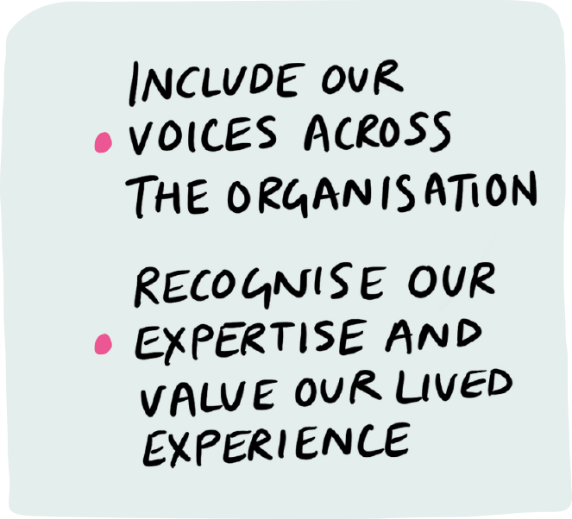

Nothing About Us Without Us
Involving Young People Values
There should be acknowledgement and respect for the lived experience of young people, recognising them as experts in their own right. “Nothing about us without us” describes the core of this. A programme that exists to benefit young people should have them involved and represented across the whole organisation.
Space must be created for young people to contribute to discussions and their roles through the lens of their lived experience, and extra care should be given to recognise the vulnerability that this can cause.

Slide 3



Questions to consider
Nothing About Us Without Us
Involving Young People Values
Could the scope of the programme be broadened? Get creative with the departments young people are involved in.
How do you create space for young people to feed into discussion and decision-making processes?
What after-care is available for the young people who have spoken of their experiences that may be connected to trauma?
How do you select the young people who are able to take part in your programmes?

Slide 4


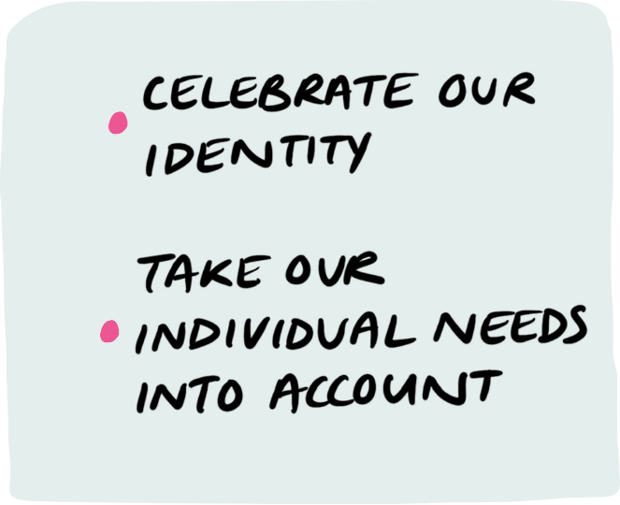
Accessibility
Involving Young People Values
It is important for organisations to take people’s different needs into consideration so that everyone feels welcomed and seen. Since there is a broad range of accessibility needs, programmes and projects should actively be asking people what they need so that they are able to meet these to the best of their ability. It is up to an organisation to proactively educate themselves on the accessibility needs of their staff and those who participate in their programmes.
It is important that young people see that their needs are listened to and respected as well as celebrated in the space.

Slide 5
Questions to consider
Accessibility
Involving Young People Values
How do you ensure that all identities feel safe and celebrated in your spaces?
How do you assess the accessibility needs of the people who take part in your programmes?
Do you have an accessibility policy in place?

Slide 6

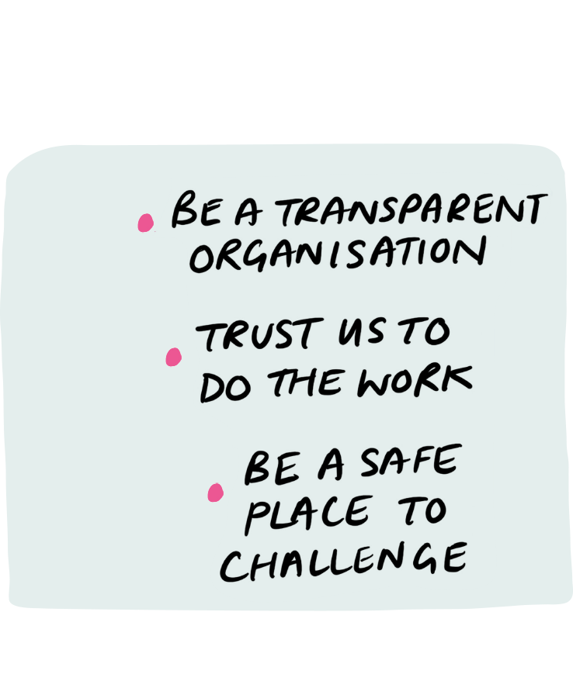

Transparency and Trust
Involving Young People Values
Trust is essential for working with young people. Organisations must believe in the young people and trust them with responsibility. The young people must also trust the transparency of the organisation.
Trust can be built by creating safe spaces to share knowledge and experiences where the young people feel they can challenge the organisation without repercussions and vice versa.

Slide 7
Questions to consider
Transparency and Trust
Involving Young People Values
How do young people access information in your organisation?
How do you build space for feedback, and what does that look like?
How do you show the young people that they are valued and not tokenisms?
Do you have an accountability mechanism for when things may go wrong/ issues need to be raised?

Slide 8


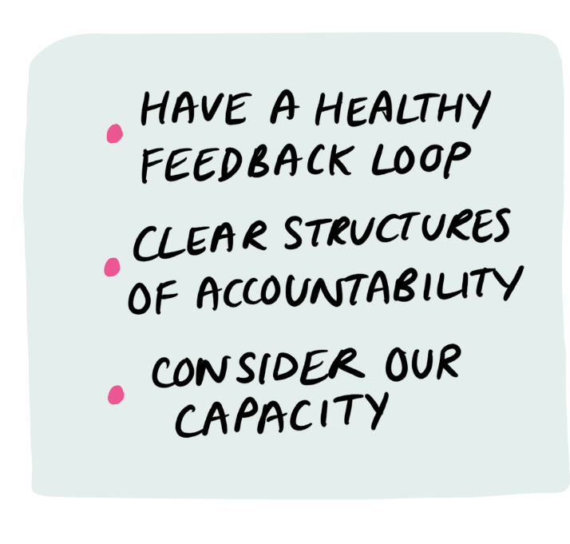
Communicating Expectations and Accountability
Involving Young People Values
Making expectations clear from the start of a programme or project creates an environment of respect and understanding. It also enables young people to take ownership of their work with certainty.
Time commitments and work capacity must be taken into account with the young people before the start of the programme and consistently throughout its duration. There should be clear structures for accountability so that any issues or concerns raised by the young people or the organisation can be addressed. These processes should be focused on understanding and learning, centering people’s wellbeing, and should not at all feel punitive.

Slide 9
Questions to consider
Communicating Expectations and Accountability
Involving Young People Values
How do you empower young people to fulfil their potential and take on more responsibility?
How much autonomy do young people have in deciding their level of commitment; can they take on more or less depending on their capacity?
How are young people active in the process of accountability? Do they contribute to the design of these structures?
How is honest feedback encouraged from young people?

Slide 10


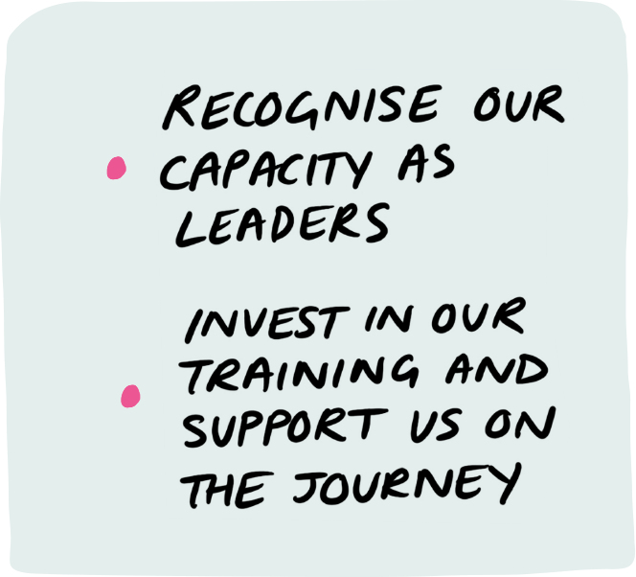
Leadership, Training and Opportunities
Involving Young People Values
Organisations must recognise young people in their capacity as leaders. This will be reflected in the opportunities young people have to be creative in their work, facilitate sessions and most importantly, that the young people feel their voice and opinions are valued. Investing in these types of opportunities demonstrates an organisation’s commitment to young people goes beyond the programmes and projects they work on.
Training allows young people to further develop and grow as they engage in a programme. An organisation involving young people will invest in training and supporting young people along their journey so that they become confident in expressing their own ideas and needs. Organisations should also have frequent training on working with different identities and the big social issues affecting communities they are working with.

Slide 11
Questions to consider
Leadership, Training and Opportunities
Involving Young People Values
What kind of extra developmental training/ opportunities are available to the young people?
How do you allow your young people to be leaders within the organisation?
Can you give an example of where the organisation has been responsive to the needs of the young people working within the organisation?
What preparation or training have staff received before and during working with young people?
How much freedom do the young people have in deciding the work they do?

Slide 12


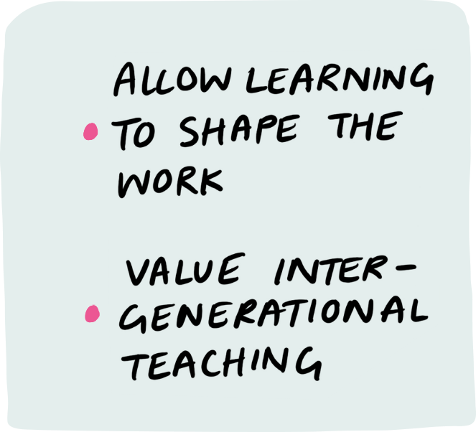
Culture of Learning
Involving Young People Values
A culture of learning is central to the successful involvement of young people in an organisation.
Organisations should be open to inter-generational teaching and should allow learning to shape the programme and the organisation through constant adaptation and improvement.
(Also see ‘Practices around reflection’)

Slide 13
Questions to consider
Culture of Learning
Involving Young People Values
Co-define what a safe space to express ideas freely looks like with young people and consider how your organisation embodies that.
How do you collaborate with young people in your projects and aims?
How is the difference of opinions between senior and young people resolved in your organisations?
How do you ensure the voices of young people are heard throughout your organisation?
How are young people represented in decision-making processes?

Slide 14


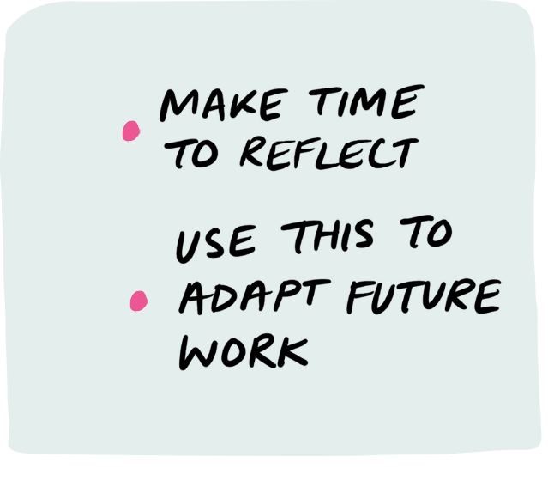
Practices around reflection
Involving Young People Values
Time should be given for both young people and organisation staff to reflect on individual events and the entire programme for the benefit of everyone involved as well as the programme and organisation.
Be active with the reflections collated, use these to adapt upcoming events and future programmes.

Slide 15
Questions to consider
Practices around reflection
Involving Young People Values
What processes do you have that allow young people to honestly and anonymously feedback on their time spent with the organisation?
How do you put feedback and reflections into practice?
How do you ensure that tangible action comes from feedback, so that these reflections are not lost?
What processes do you have that allow organisation staff to reflect on their time spent with the young people?

Slide 16


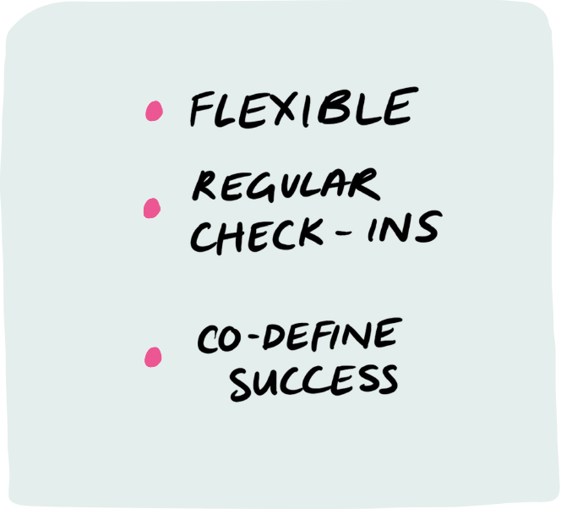
Measuring and tracking progress
Involving Young People Values
Whilst it can be tricky to do, measuring and tracking progress is important for understanding the positive impact involving young people can have on the organisation, the work, and on the young people.
Both the young people and staff should be asked what a successful programme is to them and the way this is measured should be agreed before the programme runs, bearing in mind that it shouldn’t be restrictive. There should be frequent meetings to check how both parties feel the work is going, and flexibility for adaptations to be made. It is also good practice to make a record of every moment that a young person has affected something in an organisation whether it be a decision or a culture shift so there are tangible examples of when progress is made.

Slide 17
Questions to consider
Measuring and tracking progress
Involving Young People Values
Do you already have a monitoring and evaluation process in place for tracking progress?
Do young people have a different way of measuring progress?
How do you measure the progress of involving young people in the organisation?
Do you have a way of recording this?
Are you open to altering your monitoring processes in a manner that is informed by young people?

Slide 18

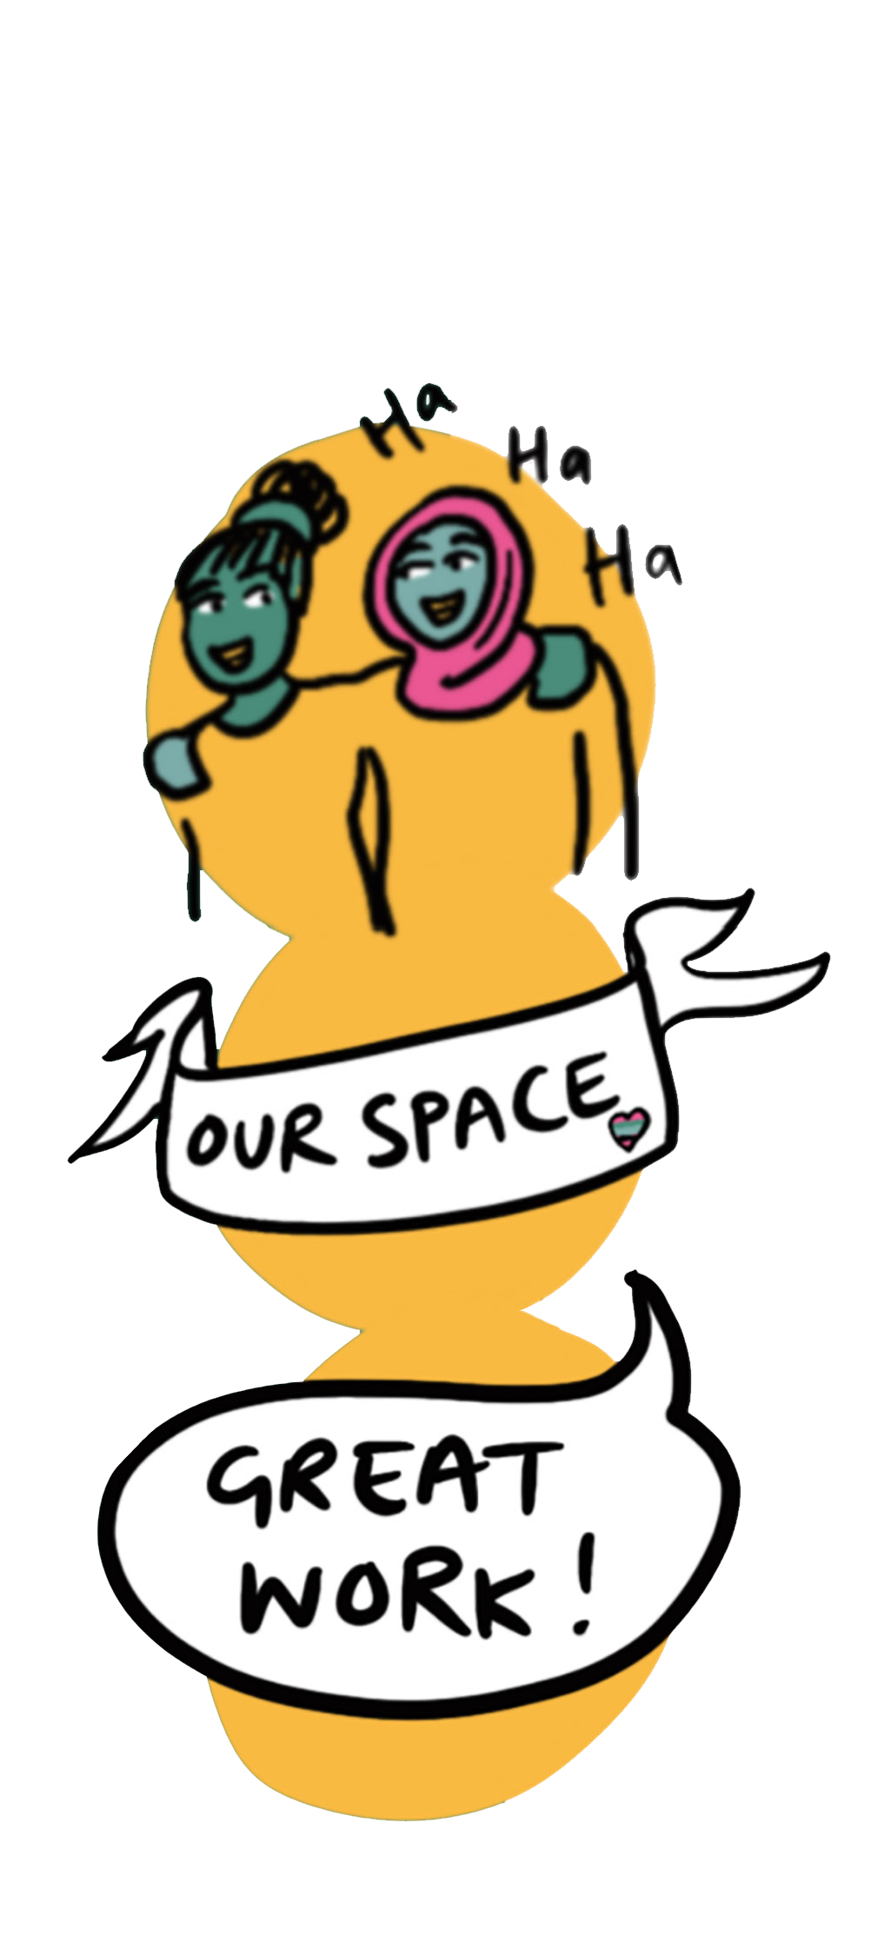

Celebration and fun
Involving Young People Values
Celebration and fun are really important when working with young people – and in general!
This can be seen in the recognition and celebration of the accomplishments of the young people, and fun social events for team bonding and creating trusting relationships. Equally as important is the celebration of the identities of the young people which is vital for making spaces safe for young people and staff alike.

Slide 19
Questions to consider
Celebration and fun
Involving Young People Values
Do people in your organisation meet for social activities for teambuilding?
How does your team celebrate after a big win or when progress is made?
How are the achievements of young people celebrated and recognised in your organisation?

Slide 20

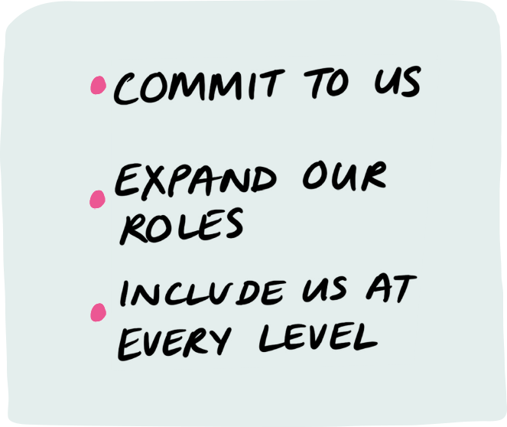
Commitment and longevity
Involving Young People Values
This is only accomplished through commitment to the programme and a deep belief that young people deserve to be at the table, that should run from the staff on the ground to the CEO of the organisation.
Young peoples’ contributions should be held central to the organisation and felt throughout the entirety of the organisation – including with the Board of Trustees, and the processes they are hired to impact, from articulating the problem to building a solution.

Slide 21
Questions to consider
Commitment and longevity
Involving Young People Values
Which processes are young people able to weigh in on and participate in?
How do you communicate and demonstrate your expectations and commitment to young people?
What accountability structures do you have in place in your organisation?

Slide 22



Thanks and acknowledgements
Involving Young People Values
We want to thank everyone who talked to us, and shared their experiences and reflections.
We’re also really grateful for
the authors of publications,
which helped inform this work.
Organisations we spoke to:
Blagrave Trust
Cripplegate Foundation
Islington Giving
National Lottery Community Fund
Paul Hamlyn Foundation
Roundhouse
Sunrise Movement
UK Student Climate Network
Virgin Money Foundation
Literature we reviewed:
Advocacy Academy Advocates Charter
Deciding together: Shifting Power and Resources through Participatory Grantmaking – GrantCraft
Hackney Youth Charter
Hart’s Ladder of Young People’s Participation
Peer Power Code of Ethics
Top 10 Best Practices for Youth-Led Innovation and Change – FRIDA The Young Feminist Fund, Global Fund for Women

